Slide 1
MEMORY SEGMENTATION IN 8086

Slide 2


Segmented Memory
Physical Memory
Code segment (64KB)
Data segment (64KB)
Extra segment (64KB)
Stack segment (64KB)
00000
The memory in an 8086/88 based system is organized as segmented memory.
The CPU 8086 is able to address 1Mbyte of memory.
The Complete physically available memory may be divided into a number of logical segments.
1 MB
FFFFF

Slide 3
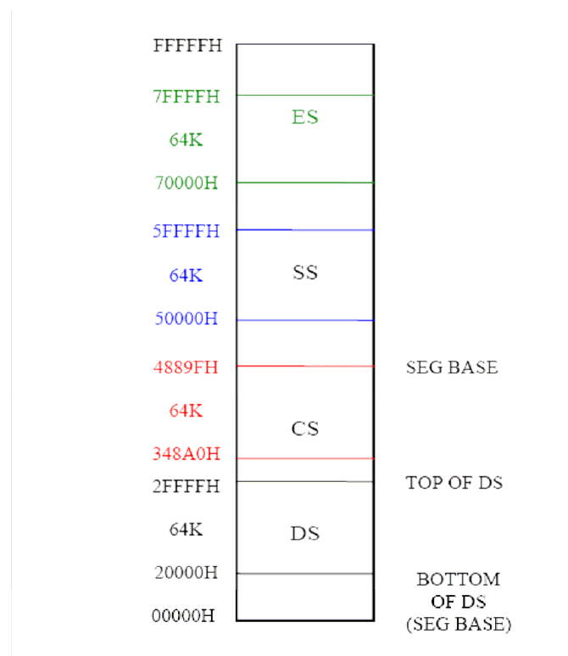
MEMORY SEGMENTATION

Slide 4
The size of each segment is 64 KB
A segment is an area that begins at any location which is divisible by 16.
A segment may be located any where in the memory
Each of these segments can be used for a specific function.
  Code segment is used for storing the instructions.
  The stack segment is used as a stack and it is used to store the return addresses.
  The data and extra segments are used for storing data byte.
  * In the assembly language programming, more than one data/ code/ stack segments can be defined. But only one segment of each type can be accessed at any time.

Slide 5
The 4 segments are Code, Data, Extra and Stack segments.
A Segment is a 64kbyte block of memory.
The 16 bit contents of the segment registers in the BIU actually point to the starting location of a particular segment.
Segments may be overlapped or non-overlapped
Advantages of Segmented memory Scheme
Allows the memory capacity to be 1Mb although the actual addresses to be handled are of 16 bit size.
Allows the placing of code, data and stack portions of the same program in different parts (segments) of the m/y, for data and code protection.
Permits a program and/or its data to be put into different areas of memory each time program is executed, i.e. provision for relocation may be done .
The segment registers are used to allow the instruction, data or stack portion of a program to be more than 64Kbytes long. The above can be achieved by using more than one code, data or stack segments.

Slide 6
Segment registers
In 8086/88 the processors have 4 segments registers
Code Segment register (CS), Data Segment register (DS), Extra Segment register (ES) and Stack Segment (SS) register.
All are 16 bit registers.
Each of the Segment registers store the upper 16 bit address of the starting address of the corresponding segments.

Slide 7
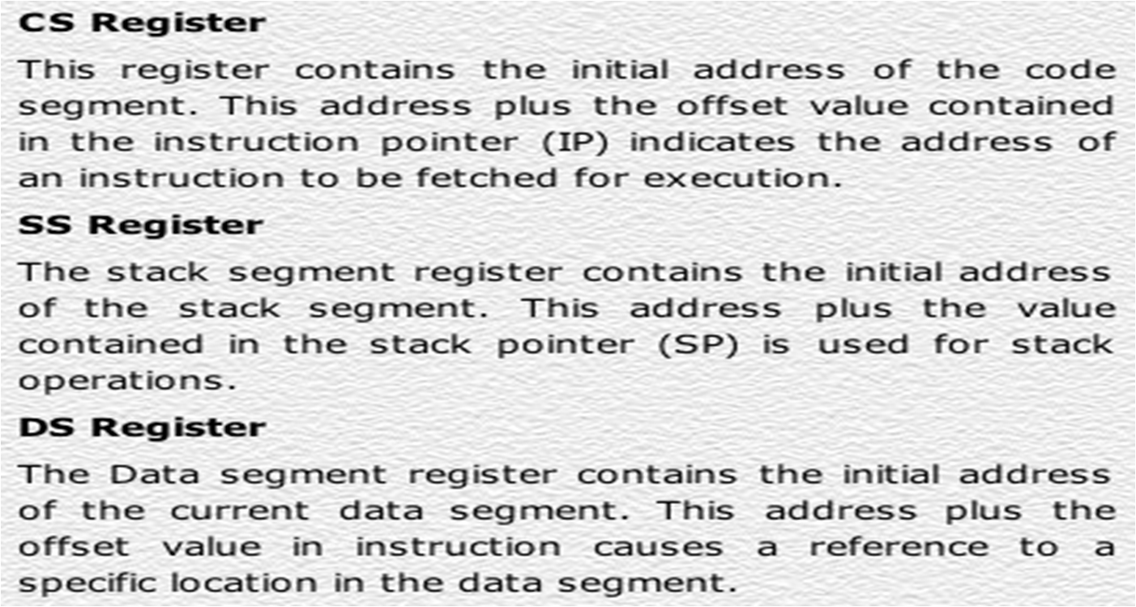
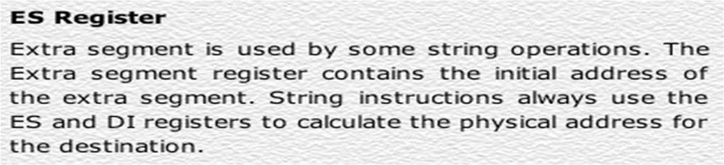

Slide 8
MEMORY
00000
BIU
Segment Registers
34BA0
CODE (64k)
44B9F
CSR
34BA
44EB
54EB
695E
44EB0
DATA (64K)
54EAF
1 MB
DSR
54EB0
ESR
EXTRA (64K)
64EAF
SSR
695E0
STACK (64K)
795DF
Each segment register store the upper 16 bit of the starting address of the segments

Slide 9
Instruction pointer & summing block
The instruction pointer register contains a 16-bit offset address of instruction that is to be executed next.
The IP always references the Code segment register (CS).
The value contained in the instruction pointer is called as an offset because this value must be added to the base address of the code segment, which is available in the CS register to find the 20-bit physical address.
The value of the instruction pointer is incremented after executing every instruction.
To form a 20bit address of the next instruction, the 16 bit address of the IP is added (by the address summing block) to the address contained in the CS , which has been shifted four bits to the left.

Slide 10
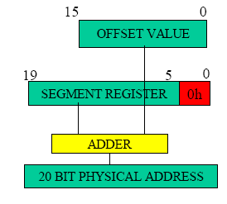

Slide 11
The following examples shows the CS:IP scheme of address formation:
CS
34BA
IP
8AB4
Code segment
34BA0
Inserting a hexadecimal 0H (0000B)
with the CSR or shifting the CSR
four binary digits left
8AB4 (offset)
3D645
3 4 B A 0 ( C S ) +
8 A B 4 ( I P )
3 D 6 5 4 (next address)
44B9F

Slide 12
Example For Address Calculation (segment: offset)
If the data segment starts at location 1000h and a data reference contains the address 29h where is the actual data?
Offset
0000 0000 0010 1001
Segment Address
0001 0000 0000 0000
0000
0001 0000 0000 0010 1001
Required Address

Slide 13
Segment and Address register combination
CS:IP
SS:SP SS:BP
DS:BX DS:SI
DS:DI (for other than string operations)
ES:DI (for string operations)

